Slide 1


Harmony in Hospitality: A Data-Driven Exploration of Prajapati Caterers and Decorators
Kaushal PRAJAPATI
Roll number: 22f2001073
Student, iitm online b.s. degree

Slide 2
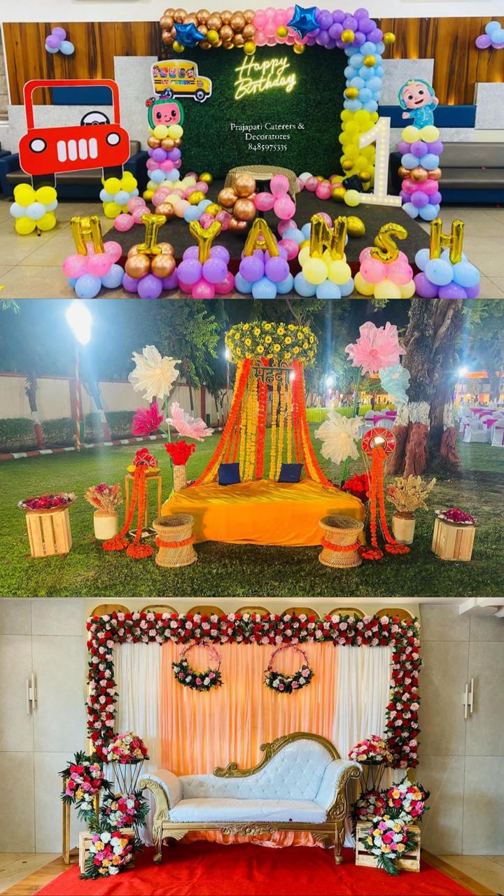
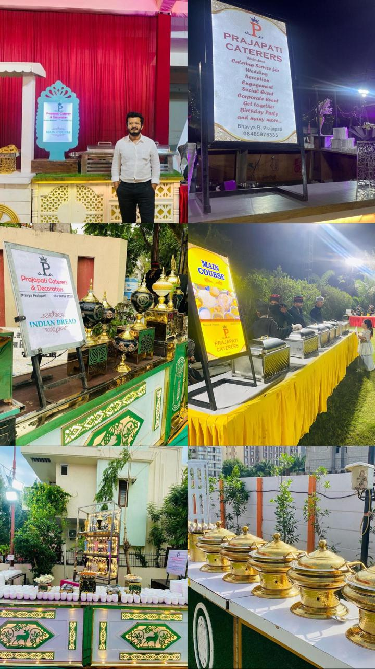
Contents
1. Introduction 2. Explanation of Analysis methods 3. Root cause Analysis and findings 4. SWOT Analysis and findings 5. Revenue Analysis and findings 6. Unit Economics & Margin Analysis 7. Other Analysis and results 8. Conclusion

Slide 3
Introduction
Prominent player in the hospitality industry, exhibits a diversified service portfolio encompassing catering and decoration services.
Known for their reliability, creativity, and customer-centric approach.
Offers varied menu options, including traditional Guajarati dishes, snacks with expertise in providing catering solution for wide range of events and occasions.
Provide innovating and thematic event decor services like balloon décor, artificial flower decor, natural flower decor etc. tailored to client preferences with creative design as their expertise.
Major business problems that the organization is facing:
Stagnant growth in revenue
Owner's Limited Availability for Order Management
Operational Hurdles - Manpower and Inventory
Having low margins on their catering business with shrinking profits
Goal of this Project:
Finding out the reasons for Stagnant growth in revenue
Addressing operational bottlenecks
Improvement via Systematic Collection and Analysis of Customer Feedback

Slide 4
Explanation of Analysis methods
Data Collection and Cleaning
Exploratory Phase
Data Collection
Data Cleaning & Refinement
Descriptive Statistics
Measures of Central Tendency
Measures of Dispersion
Time-Series Analysis
Cost & Margin Analysis based on Order Details
Comprehensive breakdown of costs, including fixed costs, manpower expenses, and monthly expenditure
Distribution of costs and revenue across various channels
Percentage Share Analysis
Margin Analysis
SWOT Analysis
Strengths
Weaknesses
Opportunities
Threats
Prioritization & Analysis of Factors and Development of Strategies
5 Whys Analysis
First Principle Thinking
Root Cause Analysis
Defining Problem → Finding Root Cause → Data Analysis → Solution Development
Trend Analysis

Slide 5
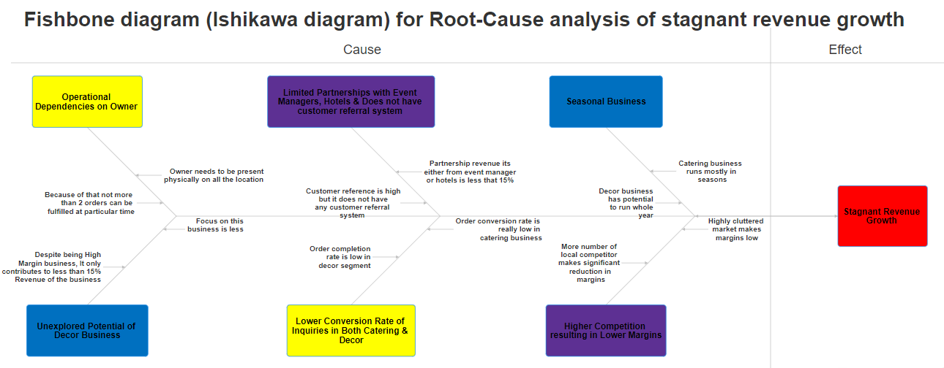
Root cause Analysis and findings

Slide 6
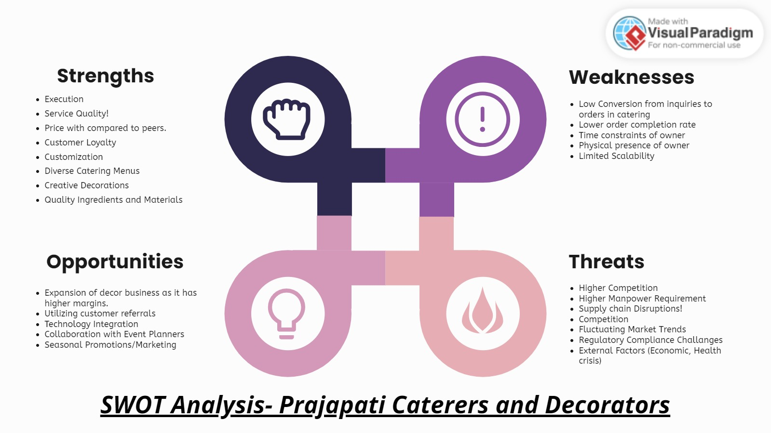
SWOT Analysis and findings
Leveraging their strengths in customization, quality, and customer loyalty
Addressing weaknesses such as low inquiry conversion & operational dependencies
Capitalizing on opportunities for expansion, referral utilization, tech integration, and strategic marketing
Mitigating threats posed by high competition, market saturation, and supply chain disruptions

Slide 7
Revenue Analysis and findings

Slide 8
Unit Economics & Margin Analysis

Slide 9
Other Analysis and results

Slide 10
Recommendations & Conclusion
Mitigate Operational Dependencies
Leverage Décor Business Potential
Enhance Inquiry Conversion Rates
Optimize Revenue Channels
Diversify Revenue Streams
Improve Operational Efficiency
Create Systematic feedback system
Identified operational dependencies hindering scalability and revenue growth
Uncovered untapped potential in décor services and opportunities for expansion
Provided actionable recommendations to mitigate weaknesses and leverage strengths
Emphasized the importance of strategic planning, operational efficiency, and adaptability
Overall Positioned Prajapati Caterers and Decorators for sustained growth and success in the competitive market

Slide 11
Thank You!🙏

